Slide 1
Bellabeat fitness case study
Vivek L

Slide 2
AGENDA
Introduction
Why do we need to find trends?
Does the trends make sense?
Summary
Recommendations

Slide 3
INTRODUCTION
Founded in 2013, Bellabeat is a high-tech manufacturer of health-focused products, specially curated for women.
The two pillars of bellabeat:
• Urška Sršen: Bellabeat’s cofounder and Chief Creative Officer
• Sando Mur: Mathematician and Bellabeat’s cofounder; key member of the Bellabeat executive team

Slide 4
Why do we need to find trends?
Let’s find out.
2022
Bellabeat case study
4

Slide 5
Key area to address
The Big Question to work this data is, How Can a Wellness Technology Company Play It Smart?
The current marketing strategy includes traditional advertising media: radio, out-of-home billboards, print, and television.
Focused on digital marketing extensively: Invests year-round in Google Search, maintaining active Facebook and Instagram pages, and consistently engages consumers on twitter.
In order to Increase the customer base, we will go through some analysis and find out where we need to concentrate.
Bellabeat case study
5

Slide 6
Data collection
What?: This Kaggle public data set contains personal fitness tracker data from thirty Fitbit users, including minute-level data for physical activity, heart rate, and sleep monitoring.
Why?: The data was to collected with an inspiration to understand Human temporal routine behaviour and pattern recognition.
Data Brief: The dataset contains 18 tables linked via the user IDs and timestamps. These tables contain information pertaining to the various intensities of physical activity, sedentary periods, calories burned (measured on daily basis, hourly basis and minute-wise basis)sleep duration(daily and minute-wise) and its frequency, weight logs, as well as heartrate.

Slide 7
Does the trends make sense?

Slide 8
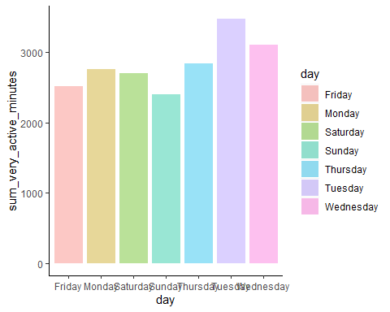
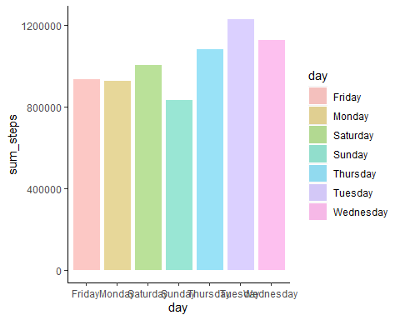
Finding the target audience
By very active minutes
By total steps

Slide 9
from the graphs we can see:
The most active days for participants are Tuesdays and Wednesdays
The least active day for participants are Sundays followed by Fridays
So the target audience for Bellabeat is one that most likely:
aims to relax and rest on the beginning and end of weekends(Fridays and Sundays)
follows a routine and remains active throughout the workdays(mon-thursdays) ,
while being most energetic and active during the mid-week period(Tuesdays and Wednesdays)

Slide 10
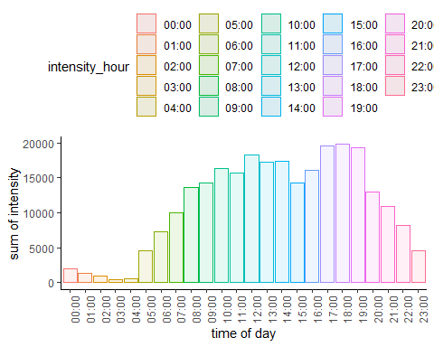
Let us also find out the time of the day when the users are most active
From the above we can note that:
The most active Time period for participants is around 5pm to 7pm
The least active timeframe for the participants is obviously the early morning hours of 2am to 4am
So the target audience for Bellabeat is one that is most likely:
full time workers who focus on their physical health after work hours are finished (5pm to 7pm)

Slide 11
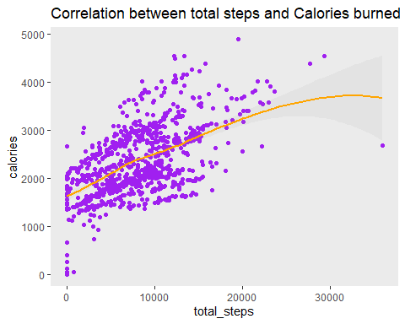
Let’s check correlation between total steps and Calories burned and we found that,
positive relation between increase in daily number of steps and calories burned
market features that involve setting and attaining goals to burn more calories by increasing the daily steps.

Slide 12
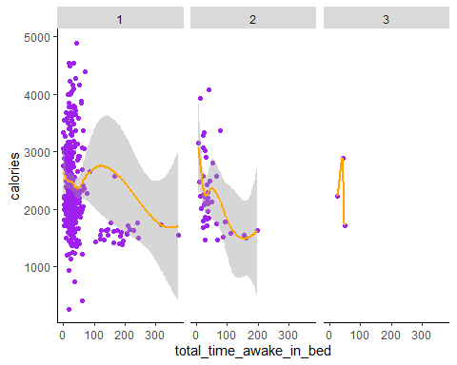
Let’s check correlation between Calories burned and the sleeplessness period in bed and we found that,
slightly negative correlation between energy expenditure throughout the day and sleeplessness while in bed.

Slide 13
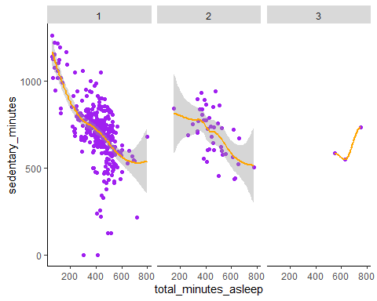
Let’s check relationship between sedantary minutes and sleep duration,
Having increased activity throughout the day is related to less awake time before sleeping.
Likewise increased periods of inactivity(sedantary minutes) is associated with poor amount of sleep
These insights can be used to market the Bellabeat for saliant feature of improved sleep with regular physical activity.

Slide 14
summary

Slide 15
Bellabeat's marketing team needs to focus their marketing towards the user segment that are:
working adults that mostly does a routine(9-5) desk jobs.
These users also have a sleepless phase of 20-30 minutes in bed before they are finally able sleep.
They remain active throughout the workdays(Mon-Thurs) but considers relaxing on the weekends.

Slide 16
recommendations

Slide 17
FOR DATA
FOR APP
sample size of the data is too small
number of participants should be equal for all the parameters
some information on the demographics of the users such as gender, age, and height , would provide deep insights for developing strategies, keeping in mind Bellabeat's vision of products curation especially for women.
Bellabeat can have enhanced features such as a water log so that users can track their hydration status and maintain their overall health.
notifications or alarms for sleep schedules
The app should include metrics to register physical activity like biking, swimming, or playing a sport, muscle strengthening exercises etc.​​​

Slide 18
What can be Bellabeat's future marketing strategy?
Market some high intensity, short duration workouts so that the customers reap more health benefits.
Market some high intensity, short duration workouts so that the customers reap more health benefits.
Since the app generates a lot of health data, this information can be leveraged to develop and sell personalised goals and activity suggestions.
Bellabeat can develop and promote sleep assisting features such as sleep inducing music, sleep journals, etc.

Slide 19
THANK YOU

